Slide 1
Weather Balloon
Megan Smith

Slide 2
Project Definition
Develop an Arduino based weather analysis balloon
Incorporate sensors to calculate humidity, pressure, temperature and altitude
Take data readings every 4-5 seconds as the weather balloon ascends
Show this change in data in real-time, on-site
Allow users to save the data
Develop a website that allows public access to the data
Create graphical representations of the data
Establish a secure system that allows an administrator to upload new data and manage the data

Slide 3
Purpose
The main purpose of this endeavor is to provide GSUs Department of Geosciences with a more hands-on undergraduate lab assignment for their Climate Literacy Labs
Hands-on activities engage students more directly and increases active learning
Introductory Geoscience labs are some of the most popular labs on campus
Students will launch the balloon with their lab instructor during their lab times
Students will be able to access the data taken during their class launch and use it in their calculations
Paves the way to add additional hands-on lab assignments in the future
Allows other educational institutions to utilize these hands-on lab assignments

Slide 4
Weather Analysis
The weather balloon climbs in altitude with time
With rising altitude comes:
Decreased pressure
As you get higher in altitude, the atmosphere becomes thinner (less pressure)
Decreased temperature
With less air pressure, there is less of a medium to hold heat
Decreased relative humidity
Relative humidity - the amount of water vapor present in air expressed as a percentage of the amount needed for saturation at the same temperature
Total amount of water vapor the atmosphere can potentially hold is decreased with decreased air pressure
More water vapor can be stored in the atmosphere at sea level (ex. 40% relative humidity) than at the top of a mountain (ex. 70% relative humidity)

Slide 5


Tools Used
Arduino Programming
Java
HTML
CSS
JavaScript

Slide 6
Arduino
Arduino Uno board used
Used as the main computing platform and memory storage for the weather balloon
Arduino is an open-source physical computing platform based on a simple i/o board
Has a developing environment that implements the Processing and Wiring languages
Can interface to various expansion board, called shields
Boards feature serial communication interfaces, including USB, for loading programs to and from personal computers
Can create devices that interact with their environment using sensors

Slide 7
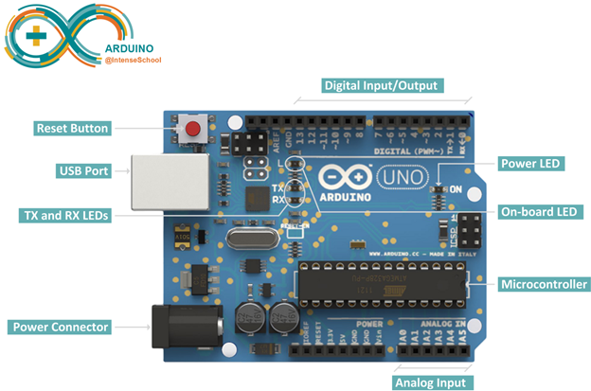
Arduino Uno Board

Slide 8
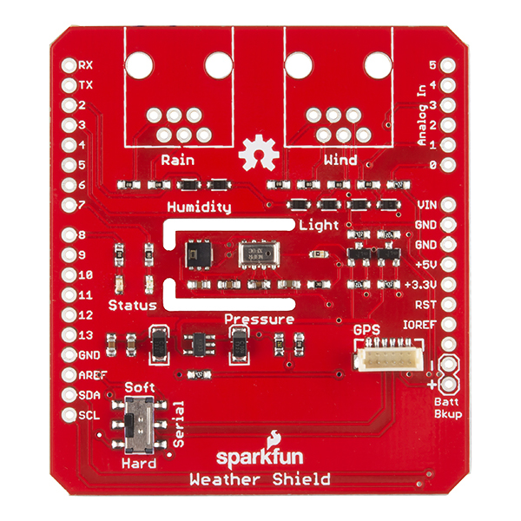
Weather Shield
Grants you access to barometric pressure, relative humidity, luminosity and temperature readings
Connections for optional sensors such as wind speed, direction, rain gauge and GPS for location

Slide 9
Xbee – Wireless Communication
Radio modules from Digi International
Allows for a reliable and simple communication between microcontrollers, computers, systems and anything else with a serial port
Supports point to point and multipoint networks
Uses the IEEE 802.15.4 standard and wraps it into a simple to use serial command set
Offers the fundamental lower network layers of a type of wireless personal area network
A lower-cost and lower-speed comparable Wi-Fi
60 mW output power
1 mile range
Built-in antenna
250 kbps max data rate

Slide 10

Xbee – Wireless Communication
The Xbee needs a shield in order to communicate with the Arduino
The shield’s form factor mates directly with any dev board that has an Arduino footprint and equips it with wireless communication capabilities using the Xbee module
The Xbee Explorer Dongle is also required
Plug the unit directly into your USB port and have it act as a gateway between your computer and the Xbee
Uses an USB-to-Serial converter that translates data between your computer and the Xbee
You must configure the two Xbee devices using the XCTU configuration and test utility software

Slide 11
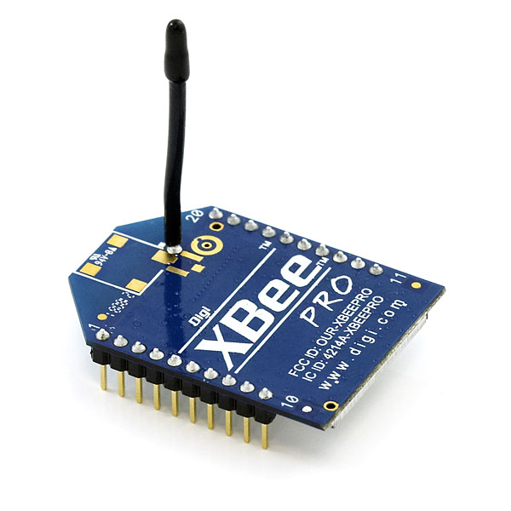
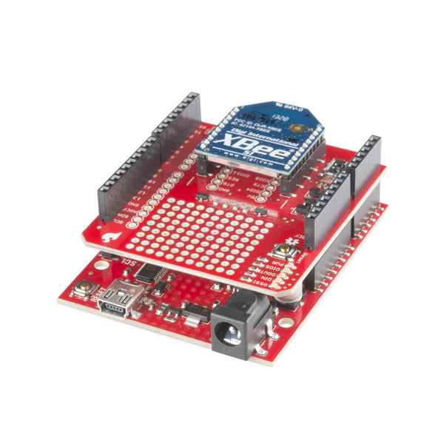
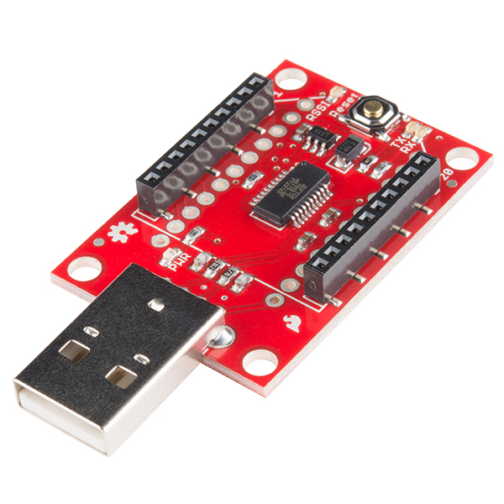
Xbee – Wireless Communication

Slide 12
Sensor Reading
The program reads the following sensors from the weather shield: humidity, pressure, battery level, and reports the received data over the serial port
From these sensors we can calculate the current environment’s humidity, temperature, pressure and altitude.
The code will also keep track of time, starting from when the Arduino was first powered on.
Units for each variable :
Relative humidity - percent humidity
Temperature - Fahrenheit
Pressure - pascals
Altitude - meters
Time - seconds
New data is generated every 4-5 seconds.

Slide 13
Sensor Reading
HTU21D myHumidity; //Create an instance of the humidity sensor
MPL3115A2 myPressure; //Create an instance of the pressure sensor
//Configure the humidity sensor
myHumidity.begin();
//Configure the pressure sensor
myPressure.begin(); // Get sensor online
myPressure.setModeBarometer(); // Measure pressure in Pascals from 20 to 110 kPa
myPressure.setModeAltimeter(); // Puts the sensor into altimeter mode

Slide 14
Weather Calculations
The program utilizes two main libraries in order to calculate current humidity, pressure, altitude and temperature values:
HTU21D Humidity Sensor Library
MPL3115A2 Barometric Pressure Sensor Library
Pressure Sensor Library
Allows an Arduino to read from the MPL3115A2 low-cost high-precision pressure sensor.
.setModeBarometer() Puts the sensor into Pascal measurement mode.
.setModeAltimeter() Puts the sensor into altimetry mode.
.readPressure() Returns float with barometric pressure in Pa.
.readAltitude() Returns float with meters above sea level.
.readTempF() Returns float with current temperature in Fahrenheit.
Humidity Sensor Library
Allows an Arduino to read from the HTU21D low-cost high-precision humidity sensor.
.readHumidity() will return a float containing the humidity.

Slide 15
Weather Calculations
//Calculate humidity
humidity = myHumidity.readHumidity();
//Calculate pressure
pressure = myPressure.readPressure();
//Calculate altitude
altitude = (myPressure.readAltitude());
//Calculate temperature
tempf = myPressure.readTempF();

Slide 16
Transmitting and Receiving Data
The data is wirelessly transmitted in real-time to a receiving device, the Xbee module connected to the Xbee Explorer USB
Each Xbee is configured to transfer and receive data at a rate of 9600 bits per seconds
XBee.begin(9600);
Sends data to the receiving Xbee shield using a simple write function
XBee.write();

Slide 17
Desktop Application
The Weather Balloon outputs the current values for humidity, temperature, pressure, altitude and time to a desktop application designed to accept the transmitted data and present that data in real-time.
The application offers the user the option to save that data as a text file.
If the user has never saved data before, a directory called “Weather Balloon Data” will be made for them
All saved data will be stored in this directory
The application also allows the user to open the Climate Literacy Labs webpage directly – a convenience for the instructor

Slide 18
Serial Port Event Listeners
This program establishes a connection with the serial port in order to listen for new incoming data from the weather balloon.
Utilizes the interface SerialPortEventListener in order to listen over the port that the Xbee Explorer USB is connected to
public class WeatherBalloon implements SerialPortEventListener
Attaches an event listener on the serial port and alerts the program once data becomes available through the port.
//attaches an event listener to the port
serialPort.addEventListener(this);
serialPort.notifyOnDataAvailable(true);
public synchronized void serialEvent(SerialPortEvent oEvent)
If there is data coming over the port, that data will be read and stored as a string

Slide 19
Displaying the Data
Uses Java Swing to create the desktop form for displaying the weather related data that is coming in from the Arduino.
public final class Output extends javax.swing.JFrame
The text area will be updated with every new data reading coming from the weather balloon
Adds the entry number for each new line of data
Ex. ‘#1’

Slide 20
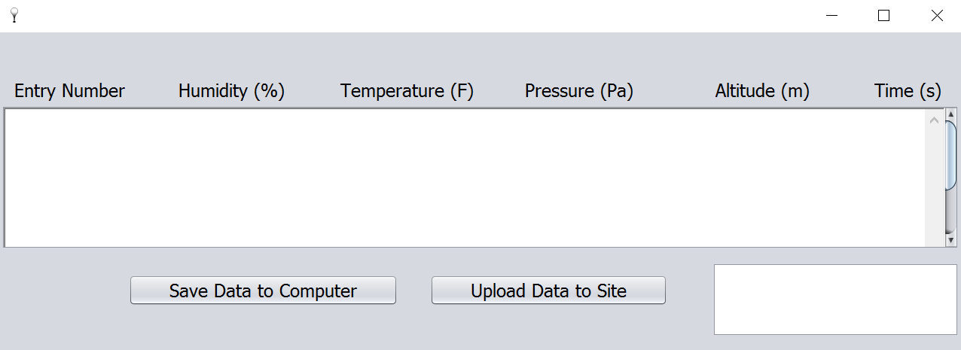
Displaying the Data

Slide 21
Saving the Data
Once the save button is pressed, the data is saved to the user’s computer
Every time the save button is pressed, everything in the text area will be saved as a new text file in the directory
Each new file will have a unique file name, with the current date and time as part of the file name
SimpleDateFormat dateFormat = new SimpleDateFormat("MM-dd-yyyy HH-mm-ss");
String fileName = "Weather_Balloon_Data_“ + dateFormat.format(date) + ".txt";
The user will be notified once the directory has been made and once the file has been saved
The data will be written to the file line by line
“#” signals a new line

Slide 22
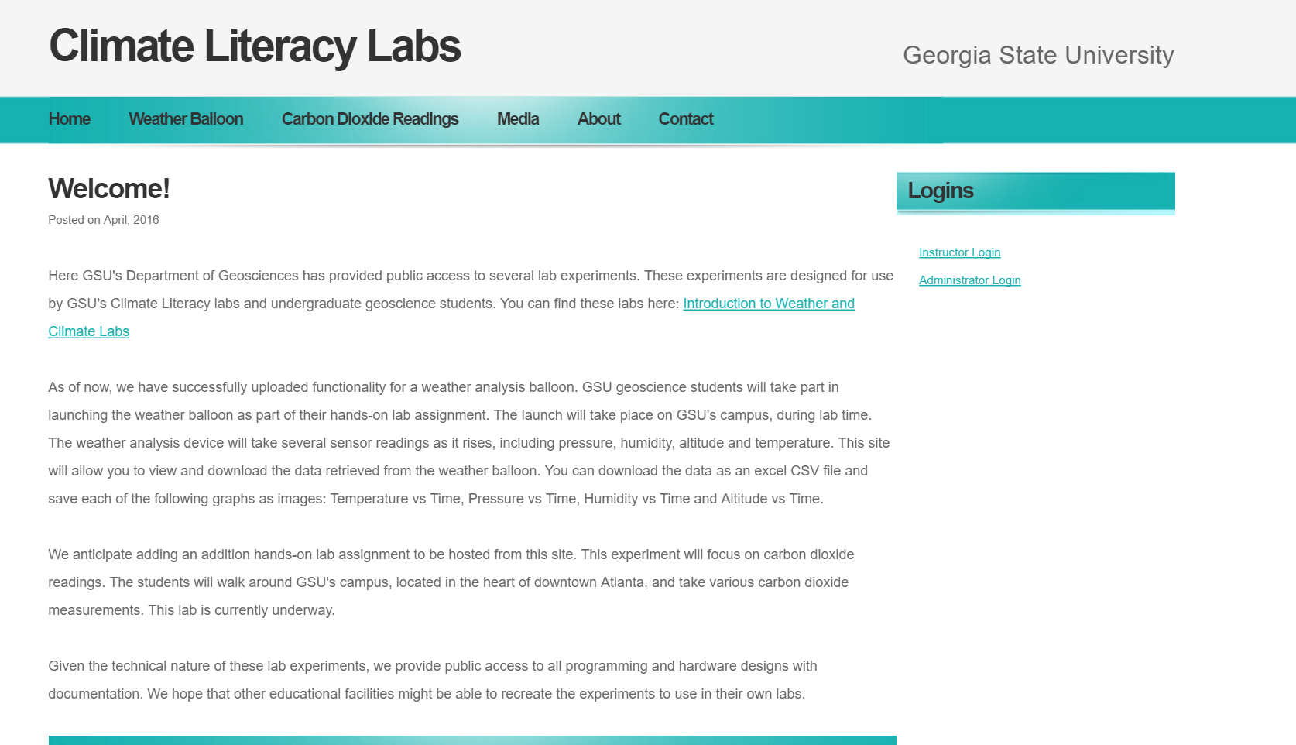
Website

Slide 23
Goals for Site
Primary goal:
Allow students to access the data they took during their lab assignment
Secondary goals:
Allow public access to the data
Possibility for use in research
Allow public access to documentation and code
Create an environment where any newly developed hands-on lab assignments can be uploaded and accessed easily

Slide 24
Weather Balloon Data
The “Weather Balloon” tab is where all the data taken from the weather balloon will be located
Each data entry will have a unique name
Instructors preference for overall name (i.e. lab CRN or instructors name)
Date the data was recorded on
The user can save the data as a .CSV file
The user can view graphical representations of the data:
Temperature vs Time
Humidity vs Time
Pressure vs Time
Altitude vs Time
The user can save each graph image as a .JPEG file

Slide 25

Taffy DB – The JavaScript Database
An open source library that brings database features into JavaScript applications
Fast and has robust cross browser support
Meant for datasets that are smaller and don’t have aggressive security and scalability requirements
SQL inspired features such as insert, update, unique, count, etc.
Reduces development time, improves performance, simplifies maintenance, and increases quality
Stores data in JSON format
Sets up a Local Storage collection for a given name

Slide 26
Download the Data
Download link for saving the data:
The file name is a concatenation of the data name given by the instructor and the date the data was recorded
dataLink.download = fileName+".csv";
Download button for saving the image of each graph for each data entry:
The file name will be the same name used for the data, in addition to that graphs title
Uses the saveSvgAsPng JavaScript file to perform the saving function
saveSvgAsPng(document.getElementById(svgID), name+".jpeg", {backgroundColor: "white"});

Slide 27
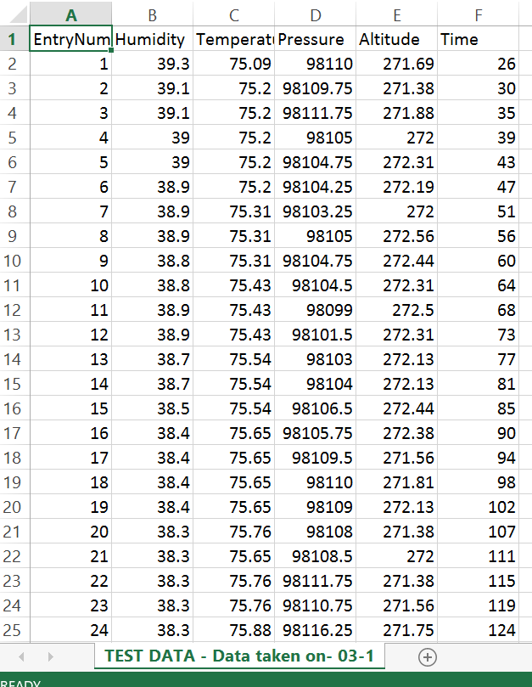
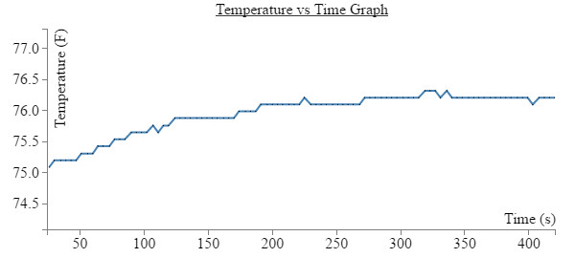
Download the Data

Slide 28

D3.js
Data Driven Documents
A JavaScript library for producing dynamic interactive data visualizations in web browsers
Allows you to bind arbitrary data to a Document Object Model (DOM), and then apply data-driven transformations to the document
Extraordinary flexibility exposing the full capabilities of web standards such as HTML, SVG, and CSS
Allows great control over the final visual result

Slide 29
View the Data
Steps to create graphs using D3.js:
Set the dimensions of the graph
Set the ranges
Define the axes
Define the line
Add the SVG canvas
Scalable Vector Graphics (SVG) is an XML-based vector image format for two-dimensional graphics
Get the data
Scale the range of the data
Add the value line path
Add the scatterplot
Add the x-axis
Add the y-axis
Add the axis labels
Add the graph title

Slide 30
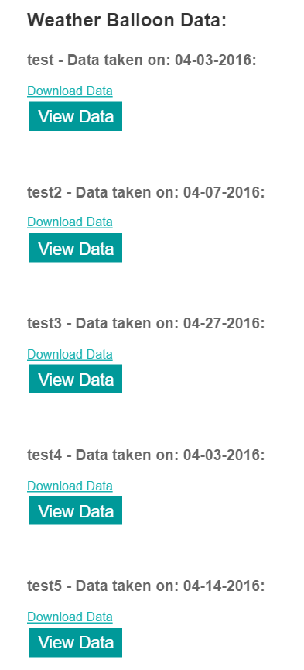
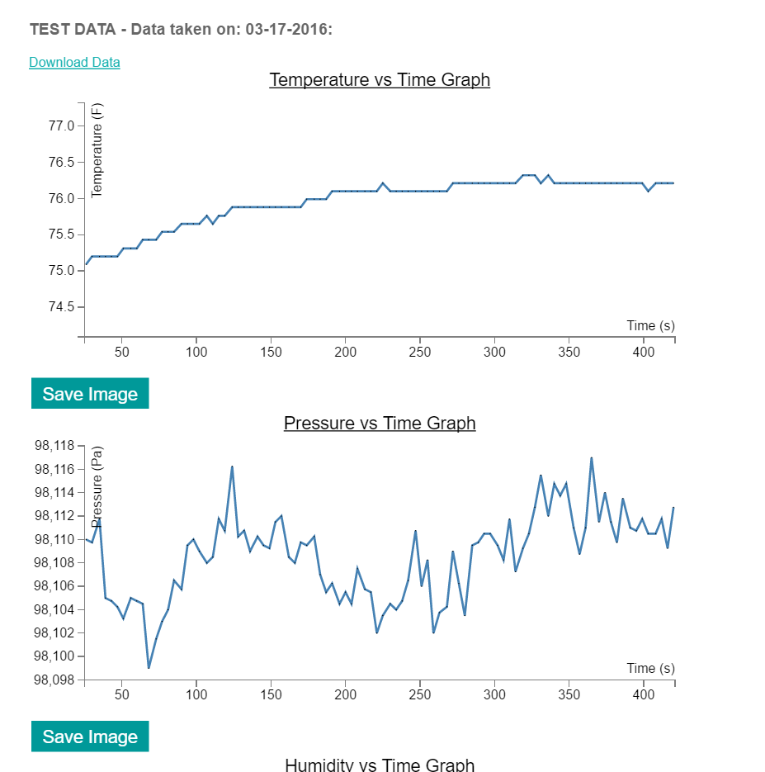
View the Data

Slide 31
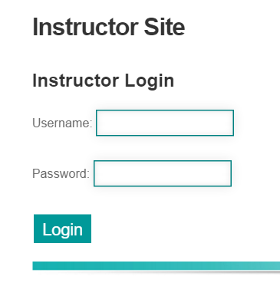
Instructor Login
A login is required for instructors
This ensures that only instructors or site administrators can manage data through the site
Only the site administrator can add an instructors username and password combination to the database
All passwords are encrypted before they are stored in the database
If the login is invalid, the user will be notified
If the login is accepted, the instructor will be able to upload new data or delete existing data from the database

Slide 32
Security
All password are encrypted by a RC4 encryption/decryption algorithm
Encoding method
Encodes a string - the password in this program
Converts the string to a byte array and call the RC4 encryption/decryption method
Returns a byte array converted to a string; done so the encoded byte array can be stored in the database as a string
Decoding method
Decodes the encoded password
Decodes the password using the same RC4 encryption/decryption method and the same secret key
Returns the decoded password as a string so the program can verify a users login
Obfuscate and unobfuscate methods
Used to scramble the secret key
Obfuscated key stored in the program
Uses the unobfuscated key when performing the RC4 algorithm

Slide 33
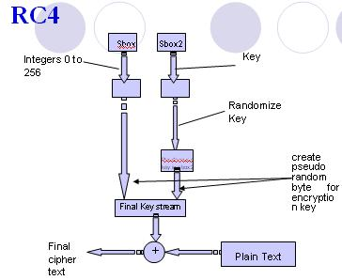
RC4
The algorithm accepts a secret key and the input to be encoded as a byte array
Creates an array with 256 elements, this will be the array we XOR our input string
Fill the stream array with integers
Randomizes the stream array based on the randomized secret key
XOR the stream array with the input string. If the string in not encoded this will encode it. If the string is encoded, this will decode it.
The algorithm returns the encrypted/decrypted byte array

Slide 34
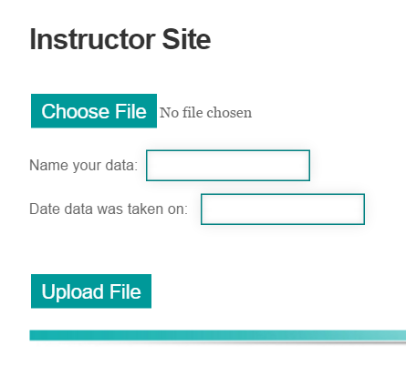
Upload New Data
Here, the instructor will upload the text file containing the data collected by the weather balloon during their lab
The program places an event listener on the "Upload File" button and will read the file once the button is pressed
Instructor must supply the data name and the date the data was taken before the file can be read
The data is then stored in the database and the user redirected to where the data is diplayed
//opens the database
var database = TAFFY();
//opens the storedGraphData table
database.store("storedGraphData");
//inserts the data and the data's name into the storedGraphData table
database.insert({data:array,name:name});

Slide 35
Dealing with Bad Data
It is important to have a way to deal with data that is not suitable to be converted into a graph
If such a file is uploaded into the system, the system will reject it
The system checks for “bad data” every time a data entry is being displayed or rendered as a graph
The method checks to see if the weather related variables (such as a value for humidity or pressure) are present in the file
If none of the correct variables are present in the file, the user will be notified of the bad data and the file will be removed from the database
database({___id:id}).remove();

Slide 36
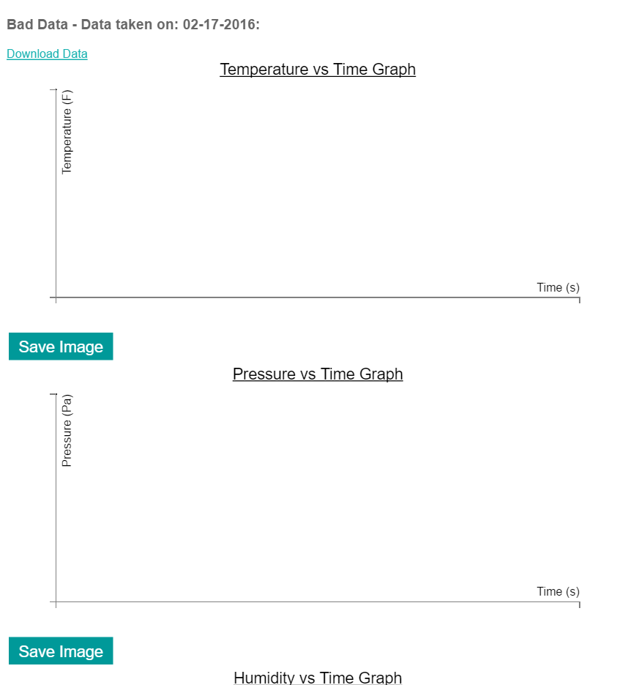
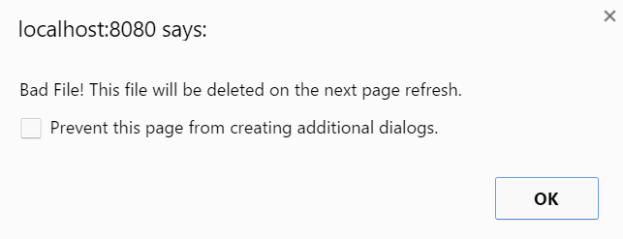
Dealing with Bad Data

Slide 37
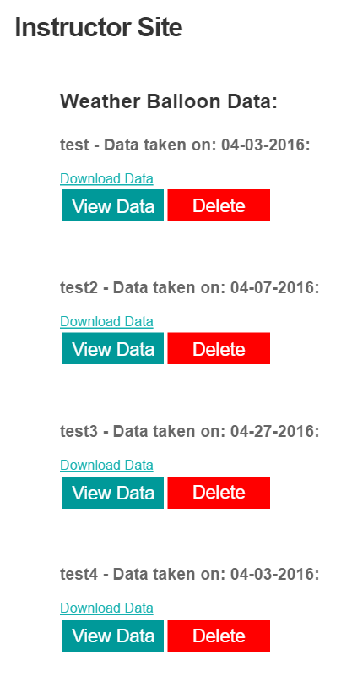
Delete Data
The instructor can delete any or all of the data at any time
In order to avoid deleting the wrong data, the instructor can also download or view the data before they decide to delete the data
Once the “Delete” button is pressed, the system will ask for confirmation from the instructor
If the instructor confirms the deletion, the data will be removed from the database
Otherwise the deletion will be canceled

Slide 38
Administrator Login
A login is required for administrators
The site administrator manages the instructors that are stored in the database
Only the administrator can insert new instructors into the system
The administrators username and password are stored in the program as obfuscated strings
There is only one administrator for the site and therefore only one username and password for the administrator

Slide 39
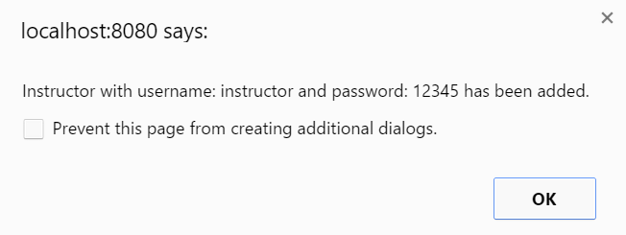
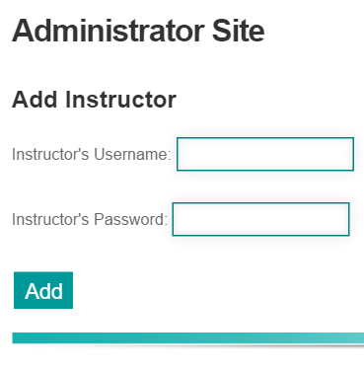
Add Instructor
The system first checks if any required inputs are empty and alerts the administrator if action is needed
It then iterates through the login table and checks to see if the given username and password combination match any combination already present in the database
Otherwise it encodes the given password before inserting it into the database
password = encode(password);
Subsequently, inserts the given combination into the login table
database.insert({instructorUsername:username,instructorPassword:password});
Alerts the user that the given combination has been added successfully

Slide 40
Testing
Tested the accuracy of changing atmospheric data
Humidity
Pressure
Altitude
Temperature
Tested the Xbees range:
Vertical range
Horizontal range
Tested basic website functionalities
Login functions
Database functions
Upload and data manipulation capabilities

Slide 41
Code Access
GitHub Link
Code available through GSUs Student Innovation Fellowship GitHub account

Slide 42
Demo…

